Slide 1

Formation MS Fabric
Fabric Data Warehouse

Slide 2
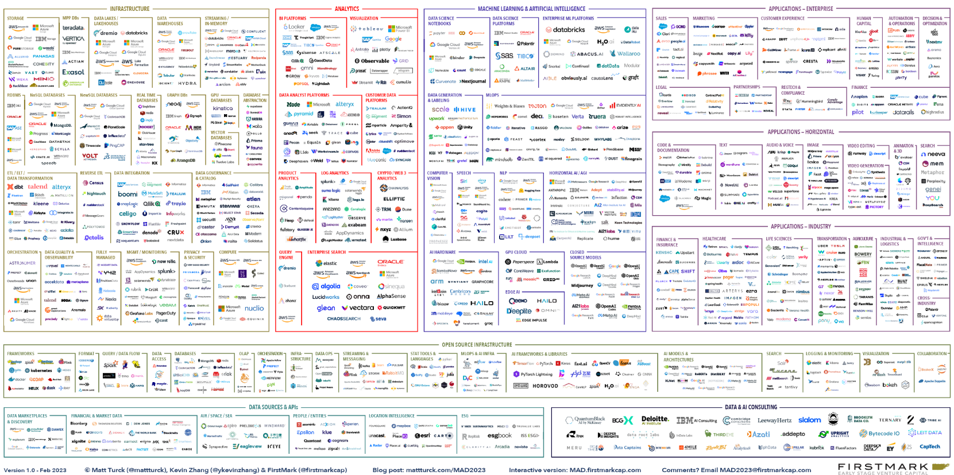
Customers enhancing their data estate face immense complexity
Notes:
For organizations trying to streamline and advance their data estate, the burden is often on you to search through the thousands of data and AI offerings, find the right set of offerings, figure out how to integrate them, and do it in such a way that is scalable and can evolve over time. Most data leaders would rather focus on the outcomes of their tools rather than spend all their time integrating specialized solutions and maintaining their data estate.

Slide 3










Microsoft Fabric
Data Factory
Real-Time Intelligence
Databases
Analytics
Industry Solutions
Power BI
Partner solutions
Copilot in Fabric
OneLake
Microsoft Purview
Notes:
Fabric combines the best of Microsoft Power BI, Azure Synapse Analytics, and Azure Data Factory to create a single, unified software as a service (SaaS) platform with core workloads—each purpose-built for specific personas and specific tasks.​
Let’s explore how all these experiences empower data and business professionals alike to unlock the potential of their data and lay the foundation for the era of AI.​ Fabric empowers every team in the analytics process with the role-specific experiences they need, so data engineers, data warehousing professionals, data scientists, data analysts, and business users feel right at home. ​
You can think of Fabric as almost as Office for Data. Just like Office 365 has word for document authoring, PowerPoint for presentations, Excel for spreadsheets, etc. in Microsoft Fabric, you have the core workloads. ​
Data Factory provides more than 150 connectors to cloud and on-premises data sources, drag-and-drop experiences for data transformation, and the ability to orchestrate data pipelines.​
Real-Time Intelligence is the combination of Real-Time Analytics and Activator, that allow you to ingest streaming data with high granularity, dynamically transform streaming data, query data in real-time for instant insights, and trigger actions like alerting a production manager when equipment is overheating or rerunning jobs when data pipelines fail.
Databases enables the streamlining of AI application development with simple, intuitive, and autonomous databases that provision in seconds. With Fabric’s new Databases workload you can unlock innovative new scenarios for AI transformation.
Analytics is also a new combination of three workloads: Data Engineering, Data Science, and Data Warehousing. Within Analytics, data professionals have all the tools they need for more complex authoring and modeling
Data Engineering enables great authoring experiences for Spark, instant start with live pools, and the ability to collaborate.​
Data Science provides an end-to-end workflow for data scientists to build sophisticated AI models, collaborate easily, and train, deploy, and manage machine learning models. ​
Data Warehousing provides a converged lake house and data warehouse experience with industry-leading SQL performance on open data formats.​
Industry Solutions allows Fabric users to not only unify their data and lay the foundation for transformative solutions, but also shortens the onramp to Fabric value for customers in Healthcare, Manufacturing, Retail, and Sustainability with industry-focused connectors, data models, and out-of-the-box templates.
Power BI in Fabric provides industry-leading visualization and AI-driven analytics that enable business analysts and business users to gain insights from data. The Power BI experience is also deeply integrated into Microsoft 365, providing relevant insights where business users already work. ​
Partner Solutions empower users to take advantage of an extensive ecosystem of partners to help drive business growth.
And with Microsoft Fabric’s new workload hub, you can discover, add, and manage partner created workloads from industry-leading ISVs like EPIC, London Stock Exchange, Informatica, and ESRI.

Slide 4








Fabric workloads for end-to-end analytics
Data Factory
Unify your data estate with a data integration experience and 300+ data transformations to easily solve the most complex ETL scenarios
Real-Time Intelligence
Ingest streaming data with high granularity, dynamically transform streaming data, query data in real-time for instant insights, and trigger actions
Databases
Streamline AI application development with simple, intuitive, and autonomous databases that provision in seconds, and unlock innovative, new scenarios for AI transformation
Data Engineering
Enable data engineers to design, build, and maintain infrastructures at scale using world-class Spark platform with great authoring experiences
Data Warehouse
Provide industry-leading SQL performance and scale, fully separating compute from storage for independently scaling and natively storing data in open Parquet/Delta Lake
Data Science
Empower data scientists and analysts to quickly build, deploy, and operationalize sophisticated AI directly within Fabric
Industry Solutions
Accelerate the transformation of your data into business value with Industry Solutions in Microsoft Fabric
Power BI
Make better, data-driven decisions with the world’s leading business intelligence platform that turns unrelated sources of data into coherent, interactive insights
Partner Solutions
Leverage Microsoft’s extensive partner ecosystem to drive business growth and profitability
Notes:
Microsoft Fabric is a unified SaaS based solution comprised of workloads, designed to target specific personas and tasks, while working seamlessly together on a unified lake-first foundation. Together, these workloads help organizations unlock the transformative value of data. Let us look at each of these key workloads in detail.

Slide 5





Data Warehouse workload
Achieve data platform goals with ease and cost efficiency, while empowering your developers and engineers of any skill level with accelerated reporting and insights
Industry-leading SQL performance and scale
Data Factory
Real-Time Intelligence
Data Engineering
Data Warehouse
Data Science
Industry Solutions
Power BI
Partner Solutions
Fully separate compute storage that can independently scale
Databases
Copilot in Microsoft Fabric
Natively store data in open Parquet/Delta Lake
OneLake
TLS 1.2 encryption protects connections for granular security across data platform
Security, Governance and Administration with Purview
Cross-database querying for fast insights and zero data duplication
Notes:
Data Warehouse allows you to achieve data platform goals with ease and cost efficiency. The Enterprise grade Data Warehouse builds relational layers on top of the physical data in the Lakehouse, providing a fully separate compute from storage that can independently scale backed by industry leading SQL performance.

Slide 6
Data Warehouse
Notes:
Seller’s note: Data Engineering, Data Warehouse, and Data Science now roll up into the Analytics workload

Slide 7


Data warehouse scenario
End-to-end analytics scenario
Data Source
Ingestion
Store
Expose
Structured
Pipelines
Data Warehouse
Business Intelligence
Warehouse
Transform
Procedures

Slide 8
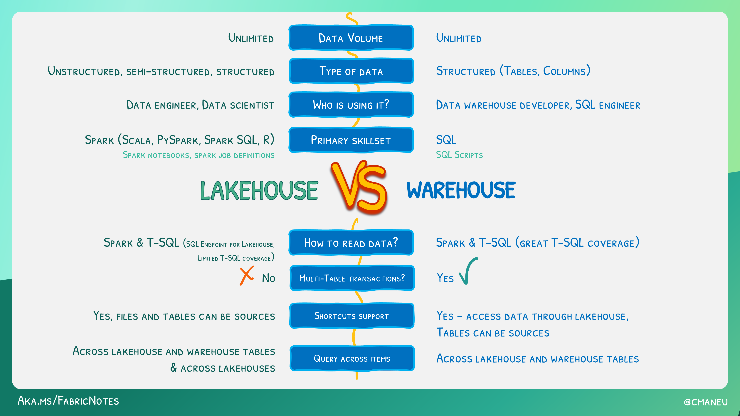
Lakehouse VS Warehouse

Slide 9
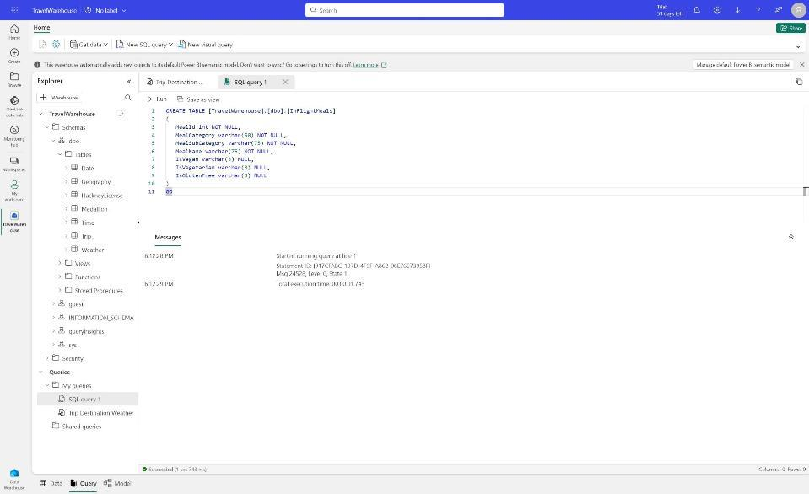
Data Warehouse | Overview
Enterprise scale data warehouse with open standard format
No knobs performance with minimal set-up and deployment, no configuration of compute or storage needed
Key Capabilities:
Lake-centric warehouse stores data in OneLake in open Delta format with easy data recovery and management
Use Fabric Mirroring for Zero-ETL integration of data from Azure SQL, Snowflake, or Azure Cosmos DB
Data loading and transforms at scale, with full multi-table transactional guarantees provided by the SQL engine
Virtual warehouses with cross-database querying and a fully integrated semantic layer
Flexibility to build data warehouse or data mesh based on organizational needs and choice of no-code, low-code, or T-SQL for transformations
Notes:
Other talking points:
Simple and intuitive warehouse experiences for both beginner and experienced data professionals
Fully integrated with all Fabric workloads out-of-the box
Enterprise-ready platform with end-to-end performance and usage visibility, with built-in governance and security

Slide 10
Data loading and transforms at scale
High scale data loading from any source.
Data managed by Warehouse compute engine provides full multi-table transaction guarantees
COPY INTO table_name.[(Column_list)] FROM ‘<external_location>’ [,...n] WITH ( [FILE_TYPE = {'CSV' | 'PARQUET' '} ] [,CREDENTIAL = (AZURE CREDENTIAL) ]
[,ERRORFILE = '[http(s)://storageaccount/container]/errorfile_directory[/]]'
[,ERRORFILE_CREDENTIAL = (AZURE CREDENTIAL) ]
[,MAXERRORS = max_errors ] [,COMPRESSION = { 'Gzip' | ’Snappy’}] [,FIELDQUOTE = ‘string_delimiter’] [,FIELDTERMINATOR = ‘field_terminator’] [,ROWTERMINATOR = ‘row_terminator’] [,FIRSTROW = first_row] [,ENCODING = {'UTF8'|'UTF16’}]
);
Key Capabilities:
Integration with Data Factory Pipelines
Data published to OneLake as Delta tables
Support for multi-statement transactions
Support snapshot isolation
T-SQL support for:
COPY command
CTAS
INSERT … SELECT
Locking:
INSERT and SELECT require schema stability lock
UPDATE and DELETE do not lock tables
CREATE TABLE [warehouseA].[dbo].[FactInternetSales_new]
AS
SELECT * FROM [warehouseB].[dbo].[FactInternetSales];
INSERT INTO dbo.EmployeeSales
SELECT sp.BusinessEntityID, c.LastName, sp.SalesYTD
FROM warehouseA.Sales.SalesPerson AS sp
INNER JOIN warehouseB.Person.Person AS c
ON sp.BusinessEntityID = c.BusinessEntityID
WHERE sp.BusinessEntityID LIKE '2%'
ORDER BY sp.BusinessEntityID, c.LastName;
10
Microsoft Fabric

Slide 11
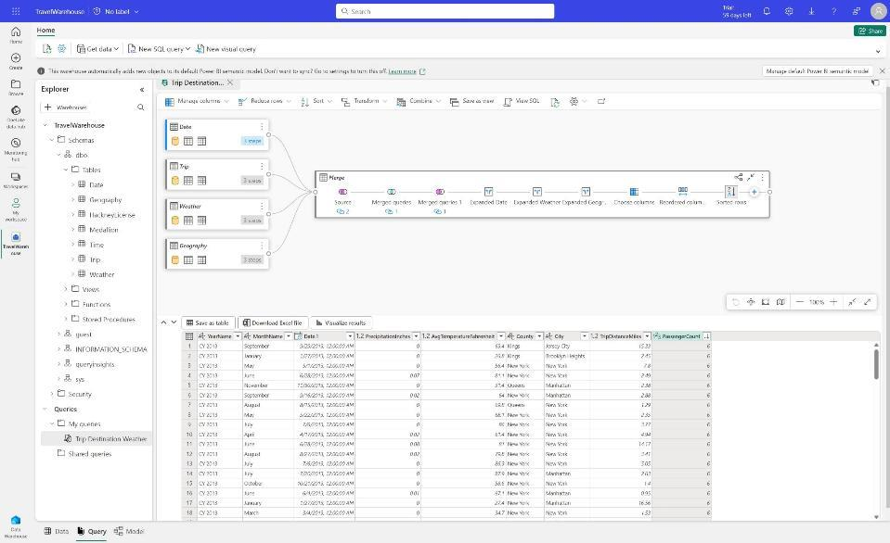
Virtual warehouses and cross database querying
Eliminate the need to duplicate data from any Lakehouse to any Warehouse
Customers can query data in the lake without the need for data movement, reducing costs
Key Capabilities:
Build virtual warehouses by creating Lakehouses with shortcuts to data in the Lake
Query across Warehouse and Lakehouse SQL Endpoint with zero data movement
Build queries visually using the Visual Query Editor

Slide 12
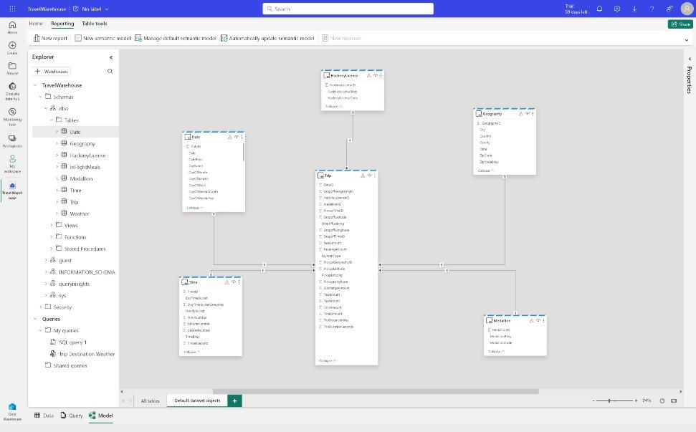
Fully integrated Power BI semantic layer
Reduce integration and gain insight from your data in seconds
Built-in Power BI enables everyone to visualize their data in seconds.
Key Capabilities:
Auto-generated semantic models always in sync
Default dataset in Direct Lake mode but automatically switches to Direct Query or Import mode as security or performance needs change
Flexibility to add/remove tables to dataset
Full web authoring experience for creating measures

Slide 13
No Knobs Performance at scale with open data format
Single node performance
Performance at Scale
(
Query optimizer
Efficiency
Query processor
Throughput
)
Multi node distribution
SQL Server QO
The best query optimizer in the industry
VertiPaq
The fastest columnar query processor in the world (originated from Power BI)
Polaris
The most scalable distributed query processor in the world with the only published Petabyte scale benchmark (VLDB 13, August 2020)

Slide 14

Autonomous workload management
Eliminate the need to manually manage different types of workloads
Built-in autonomous workload management, provides workload performance isolation and scales based on demand without any setup
…..
Query
Key Capabilities:
Workloads automatically detected and isolated based on SQL statement types
Isolated compute used for loading data, providing predictable performance for ETL
Distributed query processor auto-scales as demand increases
…..
Ingestion
14
Microsoft Fabric

Slide 15

Automatic multi-tiered caching
SQL Frontend
Result Set Caching
Get best performance out of the box
Automatic caching at multiple tiers provides top performance for queries out-of-the-box and reduces management and tuning overhead
Backend Compute Pool
Key Capabilities:
Memory caching offers the lowest latency and is designed to store the most frequently accessed data
SSD caching reduces latency in fetching from OneLake
Result set caching provides instant performance for repetitive queries
…
…
OneLake
……
15
Microsoft Fabric

Slide 16

Unified query optimization
Pull relevant metadata
Simplify query
Get best performance out-of-the-box at lowest cost
Query plan provides top performance for queries out-of-the-box at cheapest cost
Create missing statistics
Cost-based optimization
(alternatives, cost estimation)
Key Capabilities:
Query plan with optimal # of nodes for each step with efficient resource consumption automatically created
Ability to create user-defined statistics manually
Auto-create statistics ensures optimal query performance by creating statistics as needed by the query optimizer
Auto-update statistics feature (pending) ensures optimal query performance maintenance free
Plan of high quality in reasonable time
(size of search space, accuracy of estimation)
Step 1
Step 2
Step 3
Step 4
Step 5
16
Microsoft Fabric

Slide 17
Monitoring through dynamics management views
Get insights into SQL query lifecycle
Customers can view query performance and easily terminate any noisy or costly queries
-- Identifies long-running queries in order of which query has taken the longest since it has arrived, and which user executed the request.
SELECT r.request_id, r.session_id, r.start_time, r.total_elapsed_time, s.login_name
FROM sys.dm_exec_requests AS r
JOIN sys.dm_exec_sessions AS s
ON s.session_id = r.session_id
WHERE r.status = ‘running’
ORDER BY r.total_elapsed_time DESC
Key Capabilities:
Use Dynamic Management Views (DMVs) to:
Find open connections through Sys.dm_exec_connections
Find users through Sys.dm_exec_sessions
Fine queries executed by user through Sys.dm_exec_requests
Use KILL command to terminate session
-- Use the KILL command on the session with the long-running query.
KILL ‘[SESSION_ID WITH LONG-RUNNING QUERY]’
17
Microsoft Fabric

Slide 18
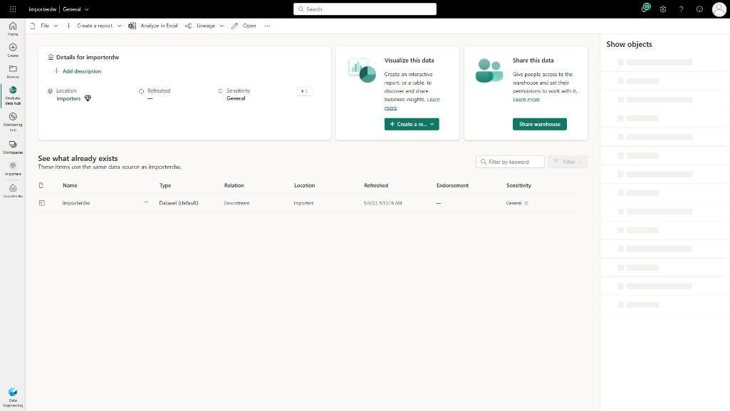
Secure by default
Keep data secure for any role accessing it and ensure peace of mind
Customers can secure their data using familiar constructs and ensure data is only visible to those authorized to do so
Key Capabilities:
Workspace roles: Workspace roles are used for collaboration with team. Add users to workspace with role assignment of Admin, Member, Contributor, Viewer
Artifact permissions: Artifact permissions are used for sharing for consumption of Warehouses. Provide access and share individual Warehouses with specific permissions
Data security: Use T-SQL, GRANT, REVOKE or DENY to secure any object within Warehouse. Users can be assigned to built-in custom roles.
Sensitivity labels: Apply sensitivity labels on your Warehouse to classify sensitive data.
Granular security: Implement row or column security or Dynamic Data Masking for granular data access control
18
Microsoft Fabric

Slide 19
Merci pour votre attention !

